Slide 1



2025 Shenandoah Housing Design Challenge
Innovative Housing Solutions for a Thriving Community
Information Session | Q&A
September 16, 2025
Be Inspired

Slide 2
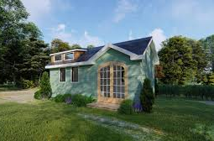
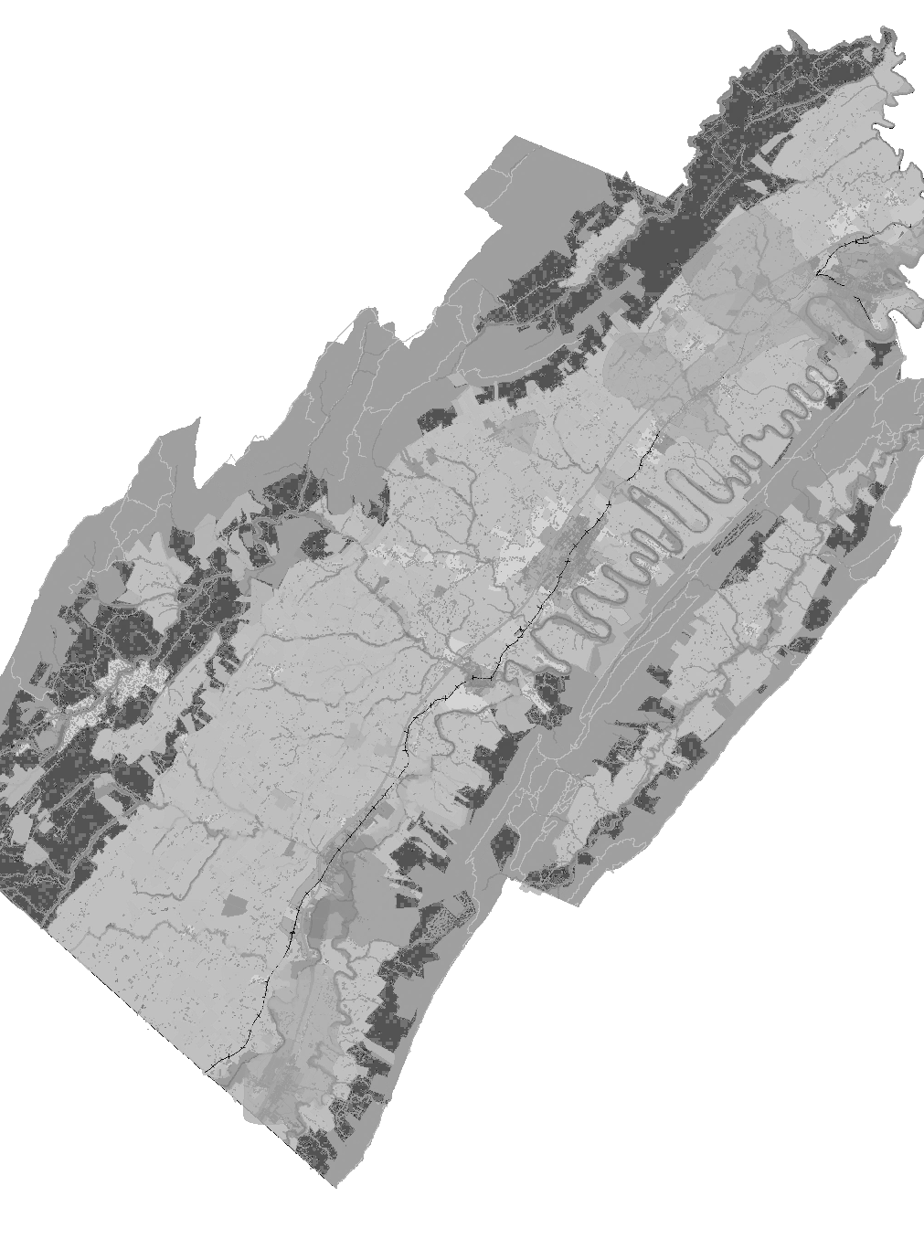
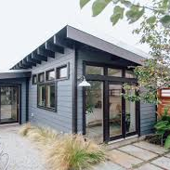
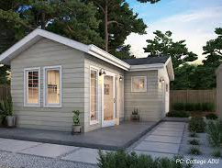
Agenda
    Goals
    Challenges
    Opportunities
    Why ADUs
    AARP Competition Guidelines
    Research
    Decision points

Slide 3

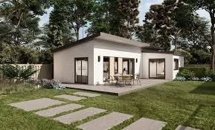
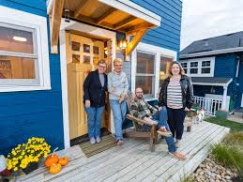
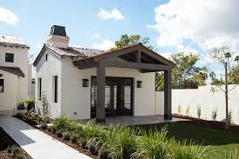
Project Goals
Expand Housing Options
Support Aging in Place
Free Up Workforce Housing
Align with Local Planning Goals
Engage the Community
Be Inspired

Slide 4
Challenges we Face
Housing prices in Shenandoah County rose from $193,000 (2019) to $320,000 (2024); some months peaking at over $500,000.
48% drop in housing inventory; 77% fewer homes sold.
Fewer options for older adults, small households, and workers.
Demand exceeds supply—especially for homes under $300,000.
Be Inspired

Slide 5
In other news…
We’ve received $40,000 from Virginia Housing
$20,000 County Market Assessment
$20,000 Woodstock Area Market Study
Virginia Center for Housing Research (VCHR)
  Comprehensive Housing Needs Assessment: detailed market analysis and evaluation of current and projected housing needs across various household types and income levels. Assess existing housing stock, housing gaps, and analyze trends.
  Infrastructure and Policy Review: The study will examine zoning regulations, land use policies, infrastructure capacity, and development incentives or constraints that impact housing development in the region.
  Public Engagement and Stakeholder Input: It incorporates feedback from local stakeholders including community members, government officials, and housing advocates through public meetings.
  Development of Strategic Recommendations: Based on the findings, the study will propose strategies and policy recommendations aimed at increasing the availability of affordable, workforce, and senior housing like changes to land use and zoning regulations.
Be Inspired

Slide 6
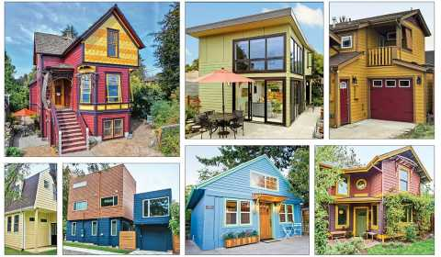
Overview
Housing Shortage in Shenandoah County
  Higher housing prices
  Low vacancy rent rates
  Scarce Aging-in-place housing
Optional Solution: Accessory Dwelling Units
Discussing AARP ADU Housing Design Competition
Be Inspired

Slide 7
Opportunity: Design for Impact
Launching a design competition to create energy and enthusiasm for real projects in our community and eventually leading to pre-approved Accessory Dwelling Unit (ADU) plans.
Enable “aging in place” solutions.
Free up larger homes for younger families.
Boost housing supply without changing neighborhood character.
Be Inspired

Slide 8
Known Benefits
Community
Downsizing
Environmental
Aging-in-place
Housing Friends & Relatives
Be Inspired

Slide 9
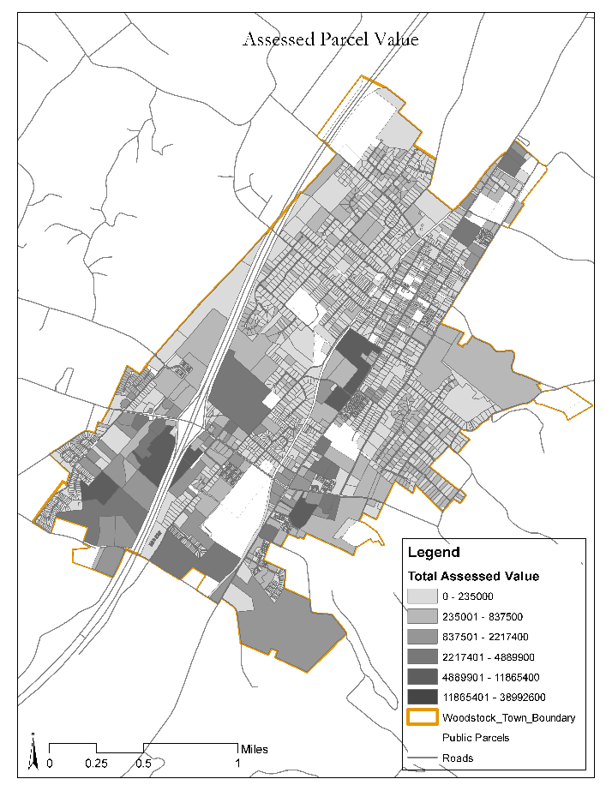
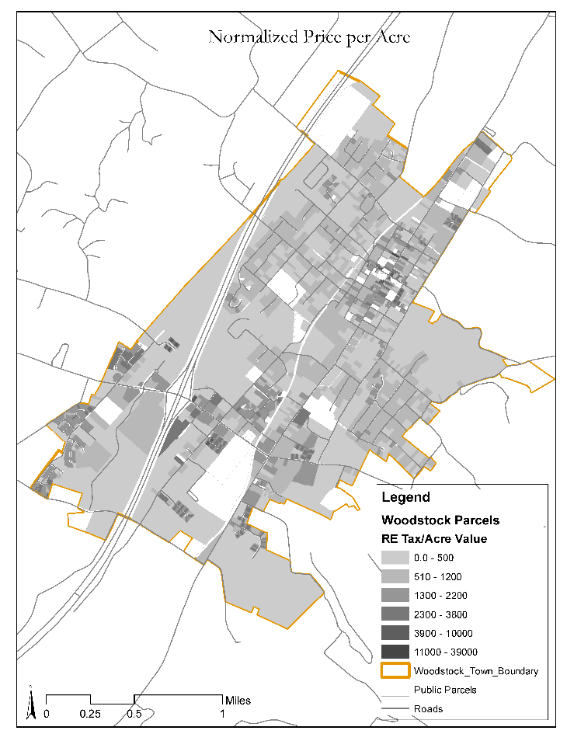
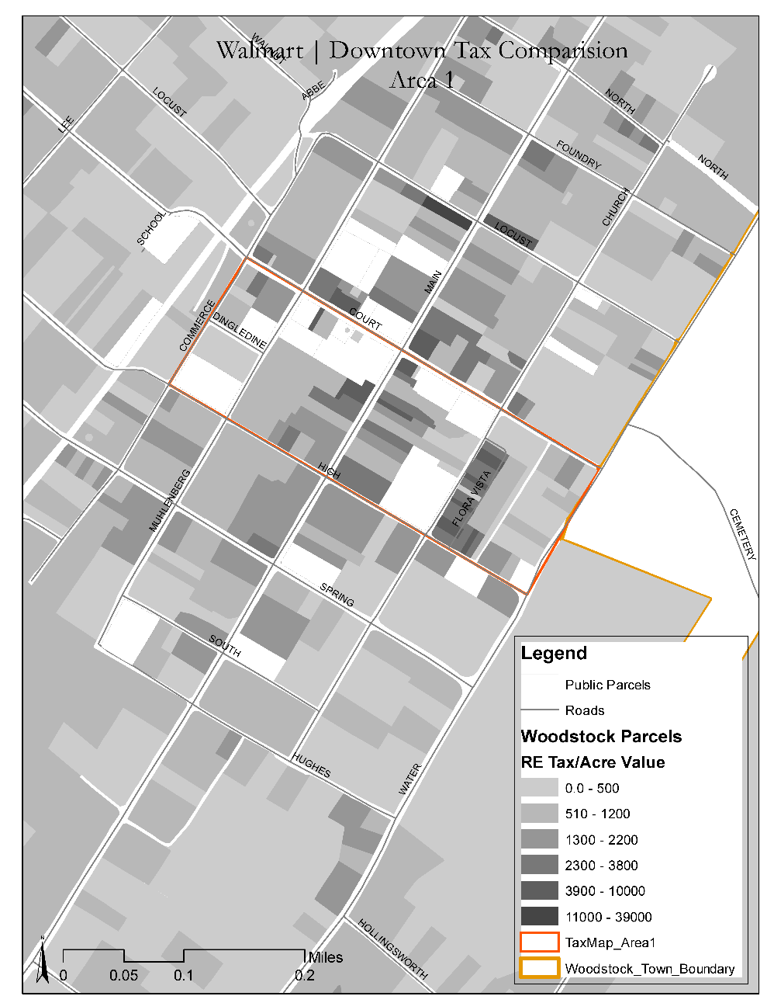
Known Benefits – Value?
Property Value vs. Value per Acre

Slide 10
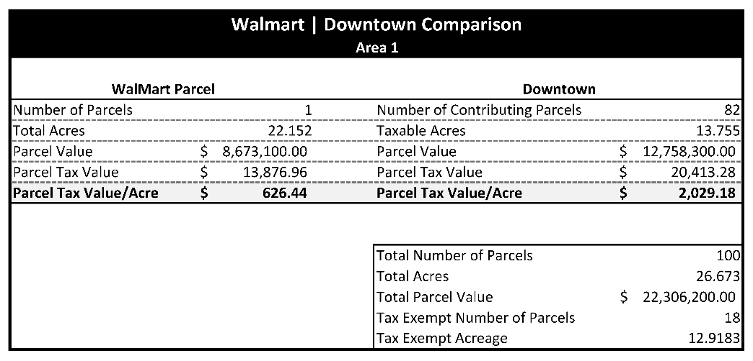
Known Benefits – Value?
Property Value vs. Value per Acre
Where is the best investment?

Slide 11
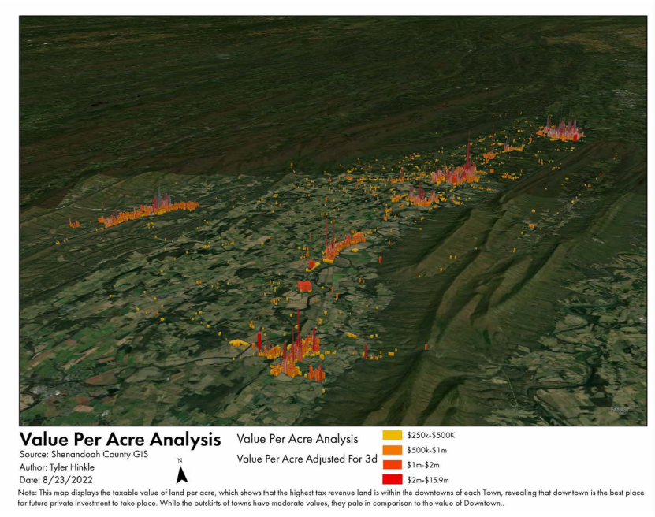

Slide 12
Why ADUs?
Launching a design competition to create energy and enthusiasm for real projects in our community and eventually leading to pre-approved Accessory Dwelling Unit (ADU) plans.
Affordable, flexible housing option for families and caregivers.
Fits within existing lots—garage conversions, backyard cottages, basement units.
Bang for your buck, more cost-effective than new homes.
Noticing trends in other states to remove local control of parking minimums, state building code changes to allow more units on ingress/egress or fire safety. Lets stay ahead…
Be Inspired

Slide 13
How the Competition Works
Open to architects, builders, students, and creatives.
Submit plans for one of three ADU types:
  Detached new construction
  Additions to existing homes
  Adaptive reuse (e.g., garages, barns)
Be Inspired

Slide 14
Competition Timeline – Thanksgiving!
October 16: Submission Deadline
  Confirm judges and logistics
  Prep Materials for Review
October/Early November: Judging and Showcase
  Review and score submissions
  Mid-October: Host public or juried showcase event
  Document with photos, community feedback, press coverage
  Begin drafting toolkit of winning designs or patterns
  Goal: Winners selected, project visibly complete.
November/Early December: Governor’s Housing Conference, Roanoke 19-21
  Final Engagement
  Prep final material for AARP Deadlines
Be Inspired

Slide 15
Town use?!
Ready-to-use plans to streamline permitting
Aligns with County Comp Plan Strategies 5.1.7, 5.2.4, and 5.3.6
Promotes intergenerational housing and local workforce retention
Aligns with recently completed or soon to be completed plans?!
Be Inspired

Slide 16
AARP ADU Competition
Grant opportunity that benefits residents, especially those age 50 and older
Implementing housing choice design competition to increase housing options and encourage implementation of policies that enable greater choice in housing
Designs will be created by YOU!
  Architects
  Builders
  Students
Be Inspired

Slide 17
Awards and Benefits of Participating
$16,000 is available in cash prizes for winning submissions:
What categories are “winning submissions”?
  Best ADU design for a new freestanding structure ($5,000)
  Best ADU design for adaptive reuse of an existing freestanding structure ($5,000)
  Best ADU design for an addition onto a primary dwelling ($5,000)
  People’s Choice Award ($1,000)
Apart from Winning Submissions, we plan to post qualified submissions on our website and showcase them
  We will also compile and share contact information for participants who wish to make it available, providing homeowners with resources to further explore ADU development.
Be Inspired

Slide 18
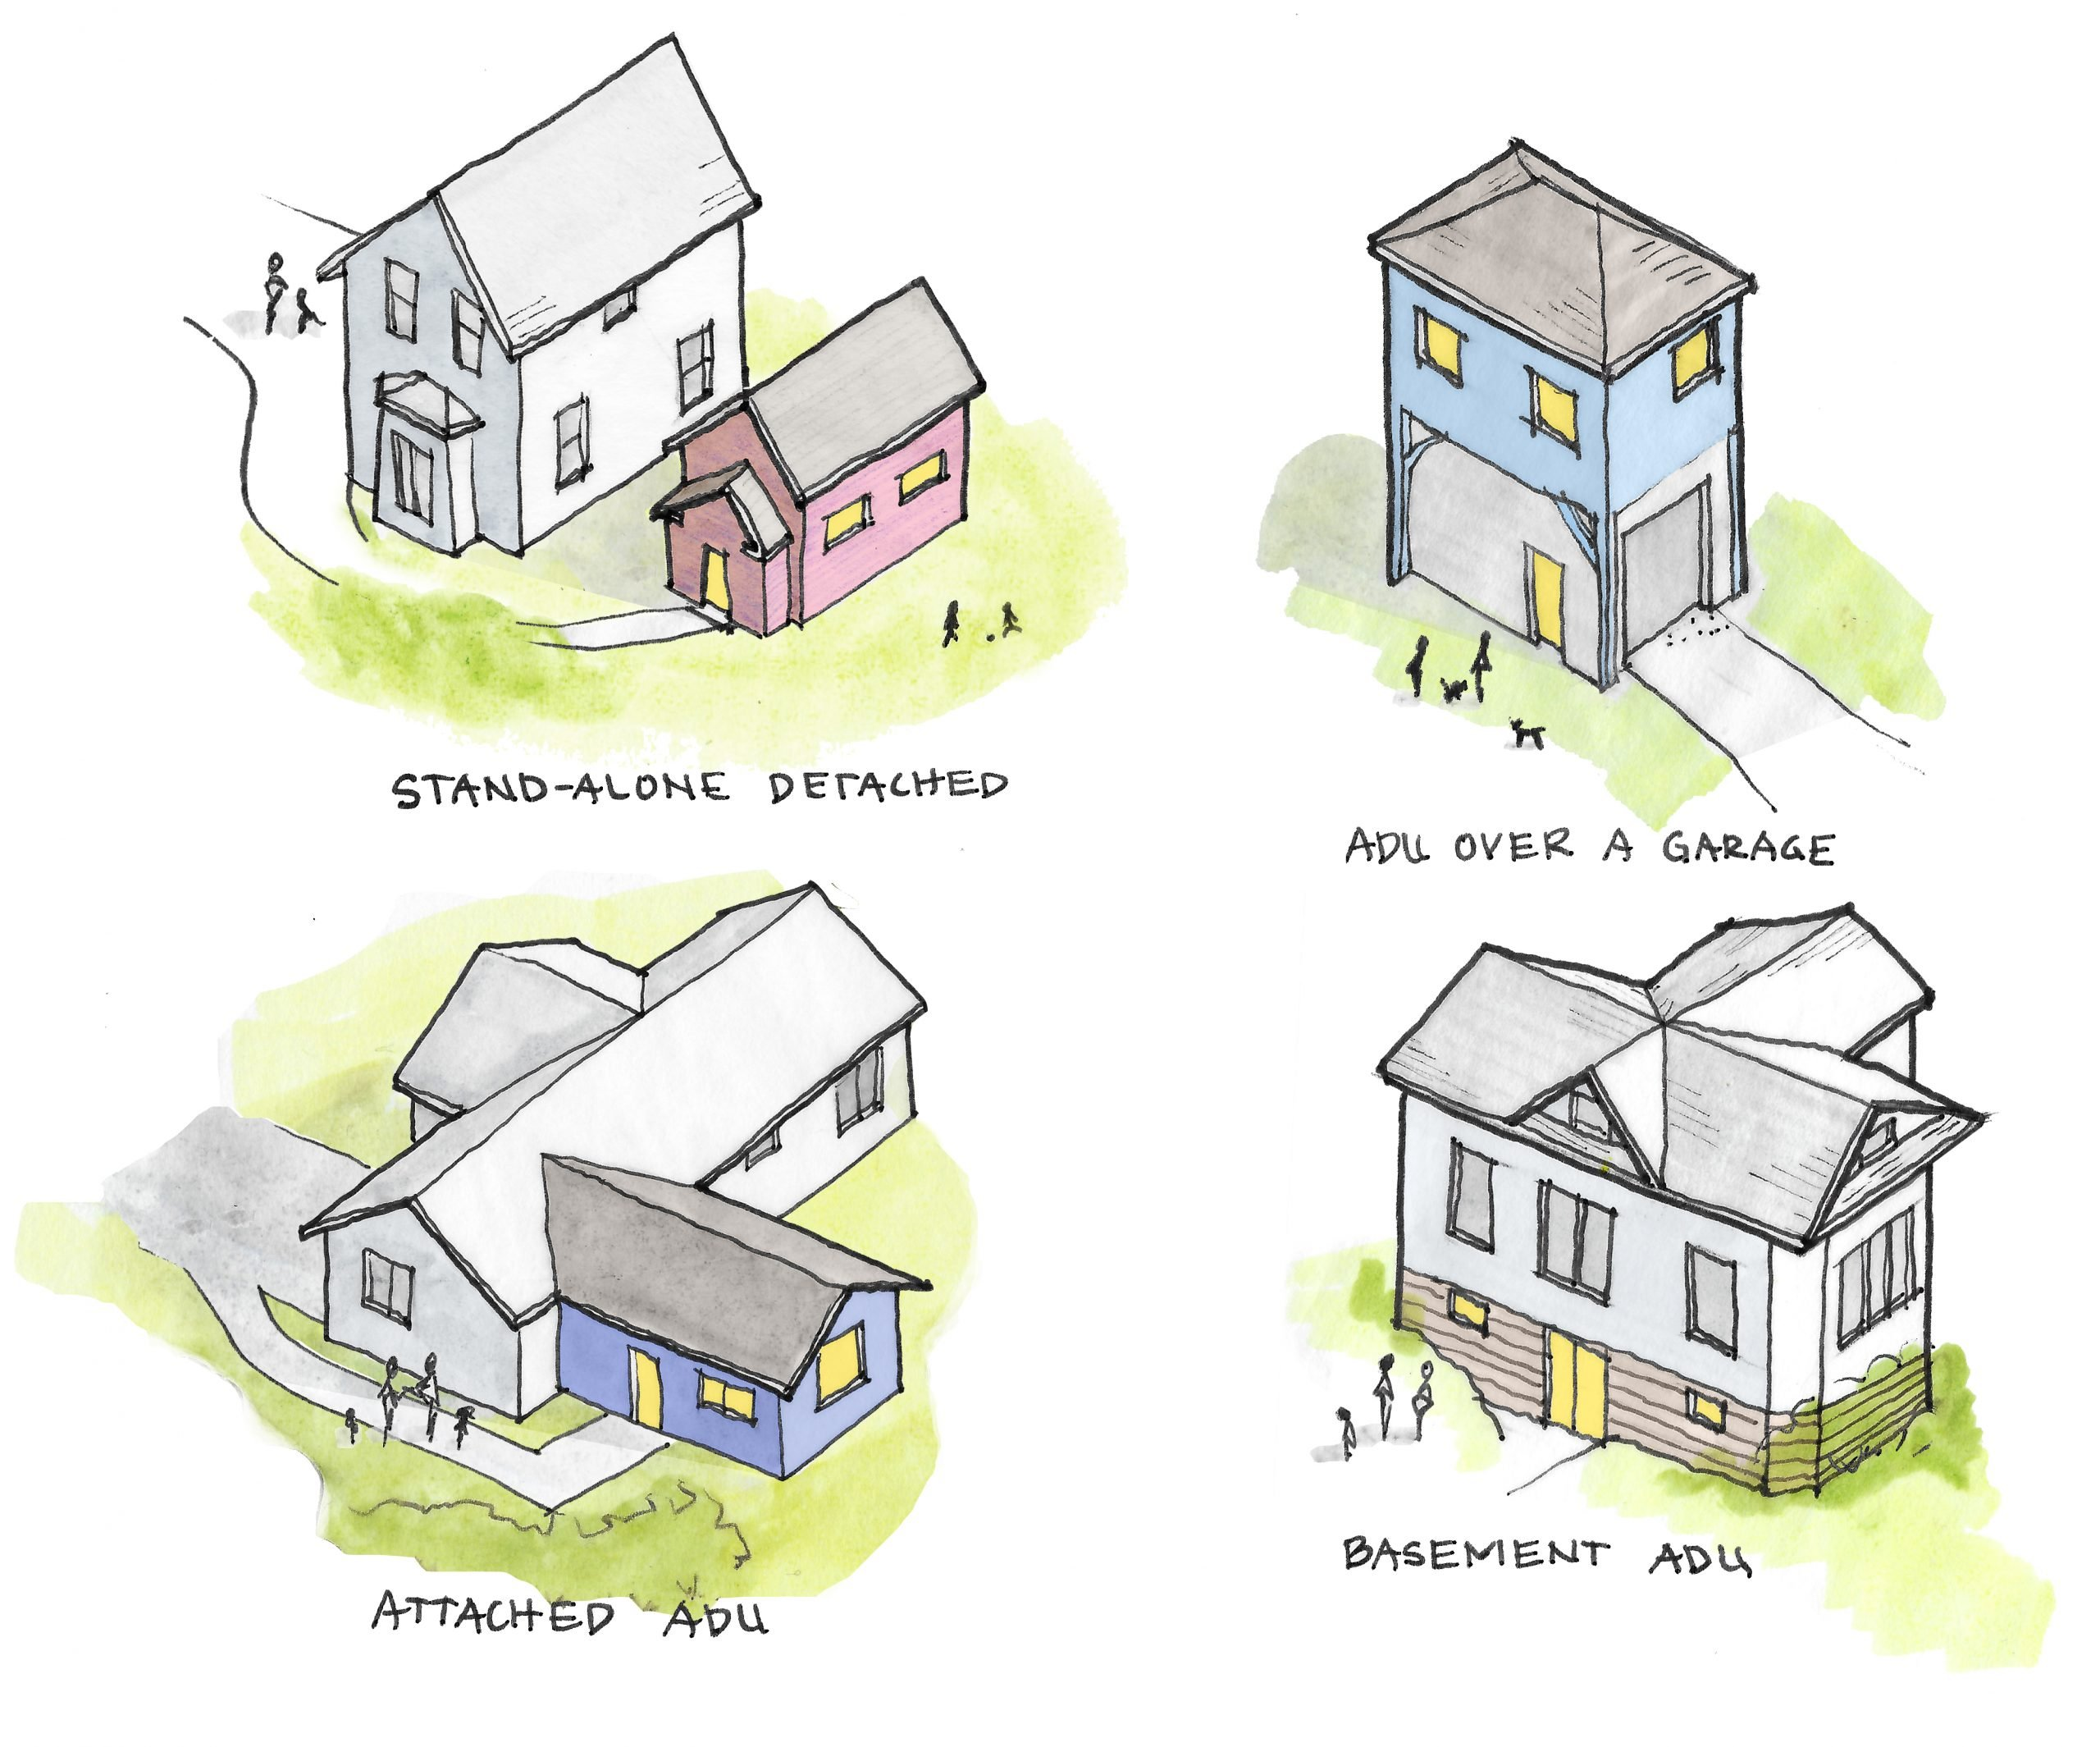
Selecting Case Study Site
Select a Case Study, each Case study will have the following:
  Various Homeowner goals
  Site Characteristics
  Regulatory environments
Case Study selects are categorized to the type of ADU the homeowner is interested in:
  Freestanding structure
  Adaptive Reuse of existing structure
  Addition to primary dwelling
    These three categories are also the cash prize categories!
Be Inspired

Slide 19
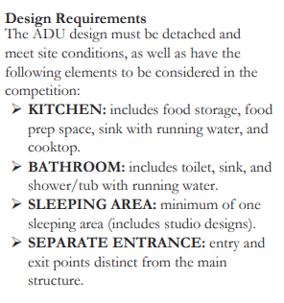
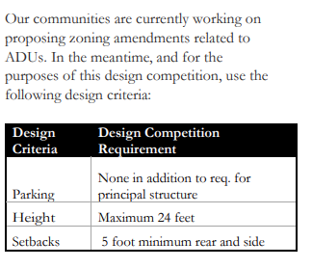
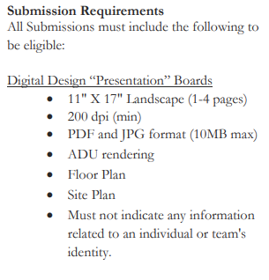
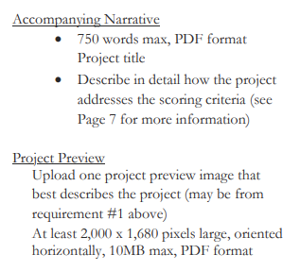
Proposal Submission Guidelines
Submission PDF’s and/or cloud-host links are to be emailed to Lemuel Hancock (lhancock@shenandoahcountyva.us) by 11:59 pm October 16th, 2025.
Be Inspired

Slide 20
Proposal Submission Guidelines
Presentation boards. Maximum 4 pages in a single PDF, 11” x 17”, portrait or landscape, 300 DPI (max) and include the Narrative. The file name should be formatted as follows: [FIRM]_presentation_boards.pdf, replacing [FIRM] with the name of your firm or your last name. Boards should include:
  Perspective rendering(s). The rendering(s) should depict the ADU’s relationship with the primary dwelling.
  Site plan (how does this proposal position itself within the existing lot)
  ADU floor plan. Planometric or 2D drawings should include annotations and dimensions as appropriate. This can be incorporated into the site plan or included as a separate drawing.
  Building elevation
Narrative. The narrative should include:
  Project title.
  The case study site, including homeowner names and town of residence.
  Description of approach and basis of design information about structure, building envelopes, finishes, mechanical, electrical, and plumbing systems.
  Conceptual cost estimate.
  Notable challenges due to site constraints and/or local land use regulations, and how the design responds to those challenges. May include images.
Be Inspired

Slide 21
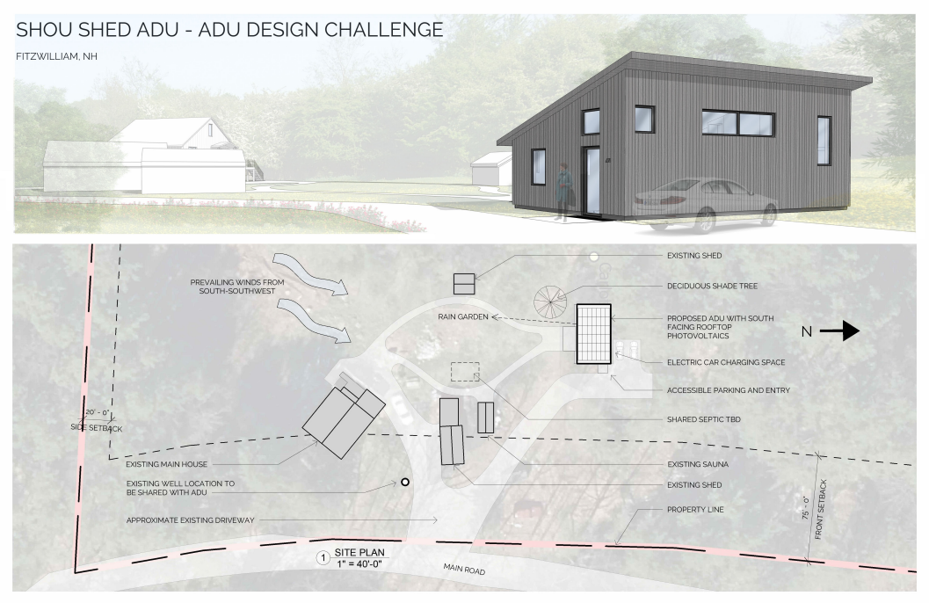
Proposal Submission Examples
Be Inspired

Slide 22
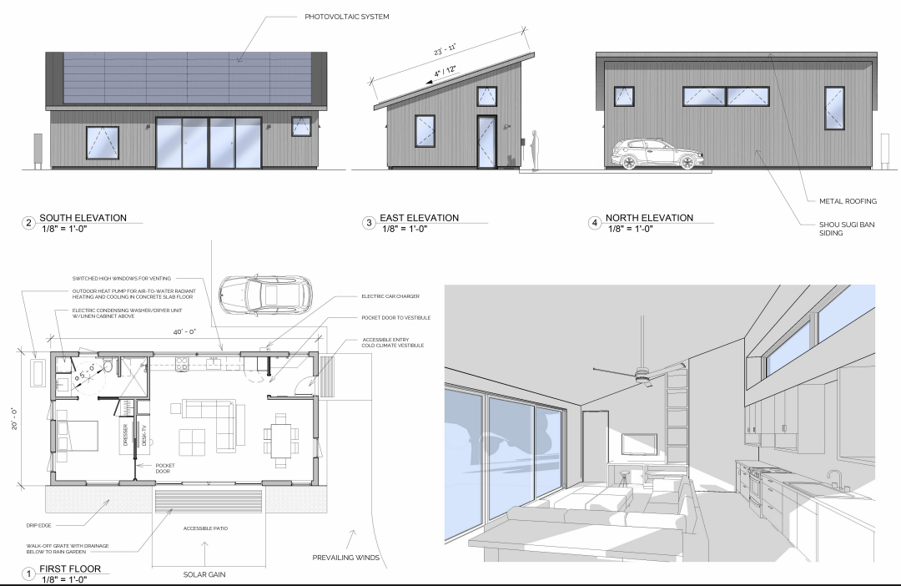
Proposal Submission Guidelines
Be Inspired

Slide 23
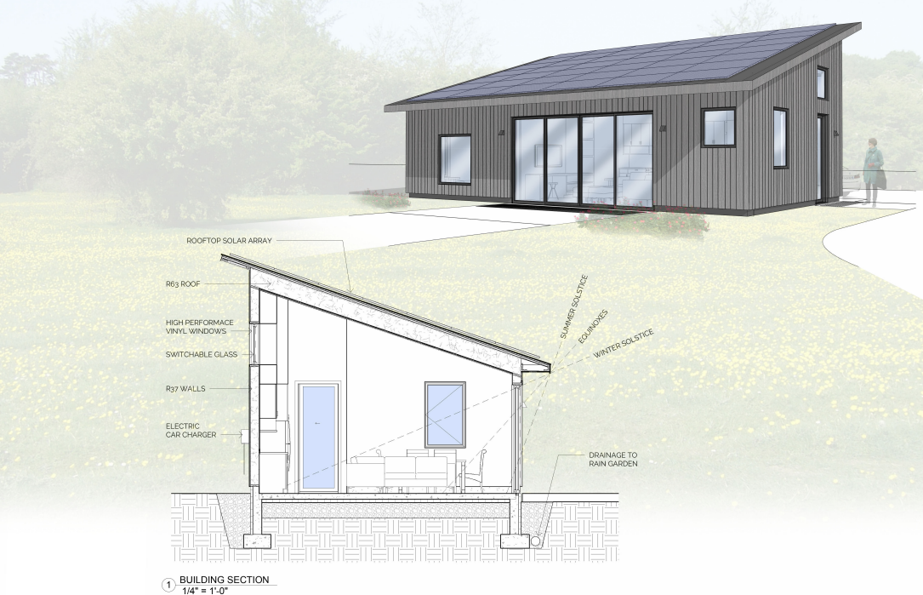
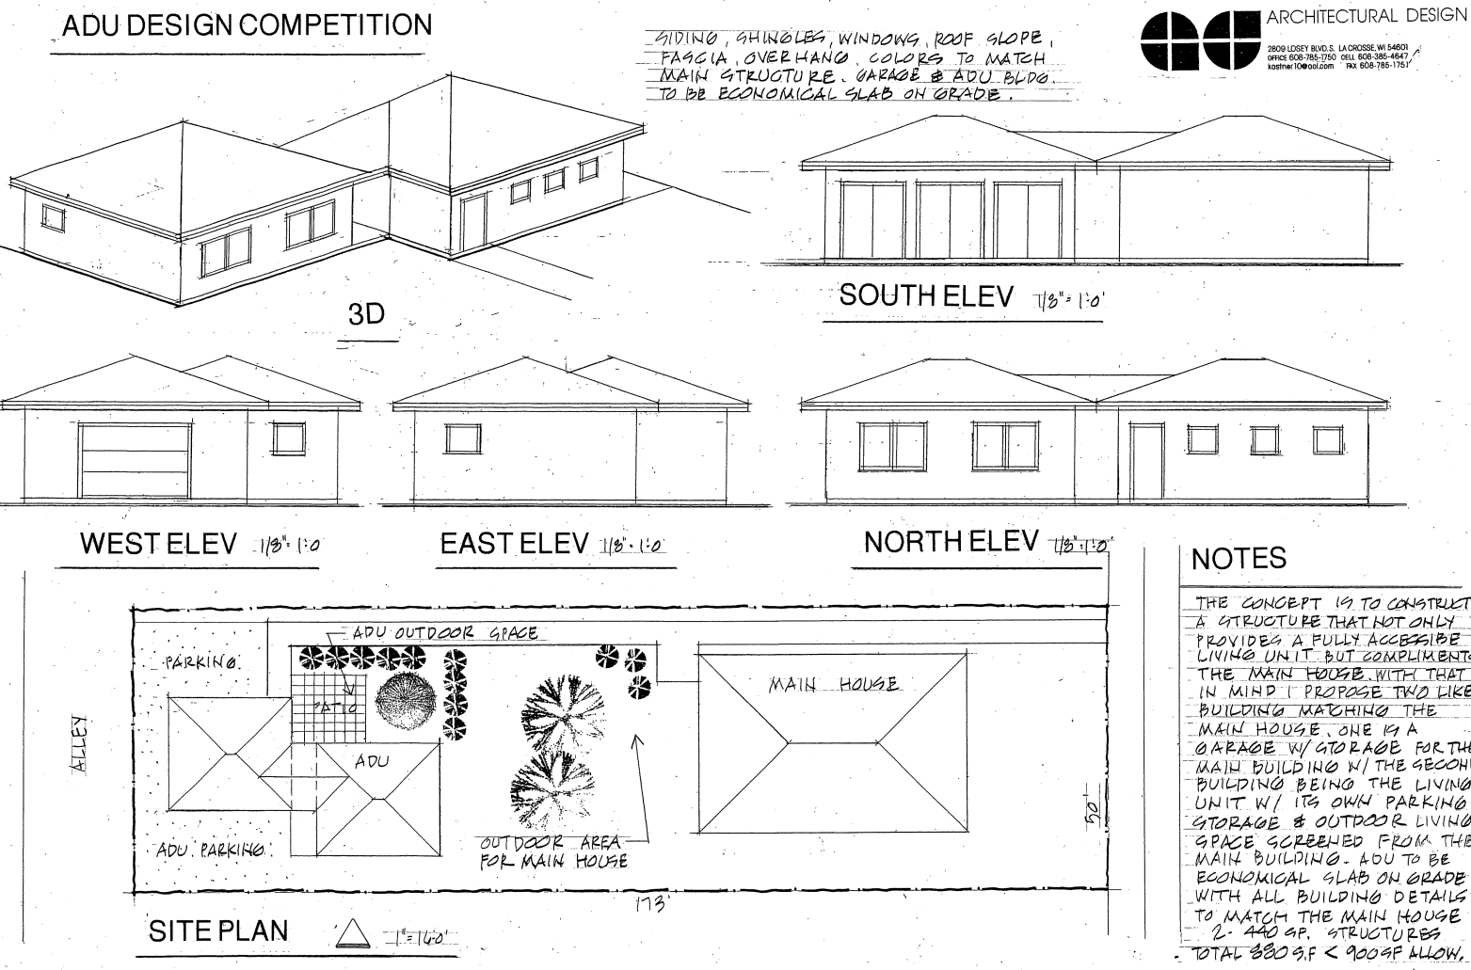
Proposal Submission Guidelines
Be Inspired

Slide 24
Ownership and Use of Submissions
Long term we want to use these as the basis for a library of ADUs in our Community
By entering the Shenandoah County Housing Challenge, each participant (or team) agrees that all submitted materials become the property of Shenandoah County. Participants grant Shenandoah County a perpetual, royalty-free, non-exclusive, irrevocable license (the “License”) to use, reproduce, publish, publicly display, distribute, and adapt the submitted designs, in whole or in part, for any lawful purpose, including but not limited to community education, public outreach, housing promotion, and future implementation. By submitting a design, each Participant agrees and acknowledges that participation in the Housing Challenge, and the opportunity to compete for the awards detailed herein, is sufficient consideration for the License, even if the Participant’s materials are not selected for an award.
Participants acknowledge and agree that Shenandoah County may share designs publicly, including online, in print, and through other media, and may use the submitted materials in reports, planning tools, or publicly accessible design libraries. Shenandoah County reserves the right to credit the designer(s) in any such use but is not required to do so.
Submission of an entry constitutes the participant's agreement to these terms. Our goal is to use this project as a basis for generating support for pre-approved housing designs available to our community.
Be Inspired

Slide 25
Scoring Criteria
Category | Max. Points
Sustainability and resilience. The submission prioritizes sustainability and energy efficiency, with features such as efficient insulation, renewable energy integration, indoor air/environmental quality, water efficiency, and resilience to potential hazards | 15
Affordability and cost-effectiveness. The submission is affordable and cost effective, considering construction costs, ongoing maintenance, and operational expenses. | 15
Accessibility and universal design. To the maximum extent possible, the submission is accessible and inclusive, incorporating universal design principles to ensure usability and adaptability for all users, including people with disabilities. | 15
Innovation and creativity. The submission demonstrates innovative design solutions and creative use of space. | 15
Aesthetics and contextual integration. The submission is visually appealing and contextually integrated with the surrounding environment. | 15
Responsiveness to unique homeowner needs, goals, and site characteristics. In addition to the general criteria listed above, the submission clearly responds to the needs and goals articulated in the homeowner profile as well as site-specific conditions. | 25
TOTAL: | 100
Be Inspired

Slide 26
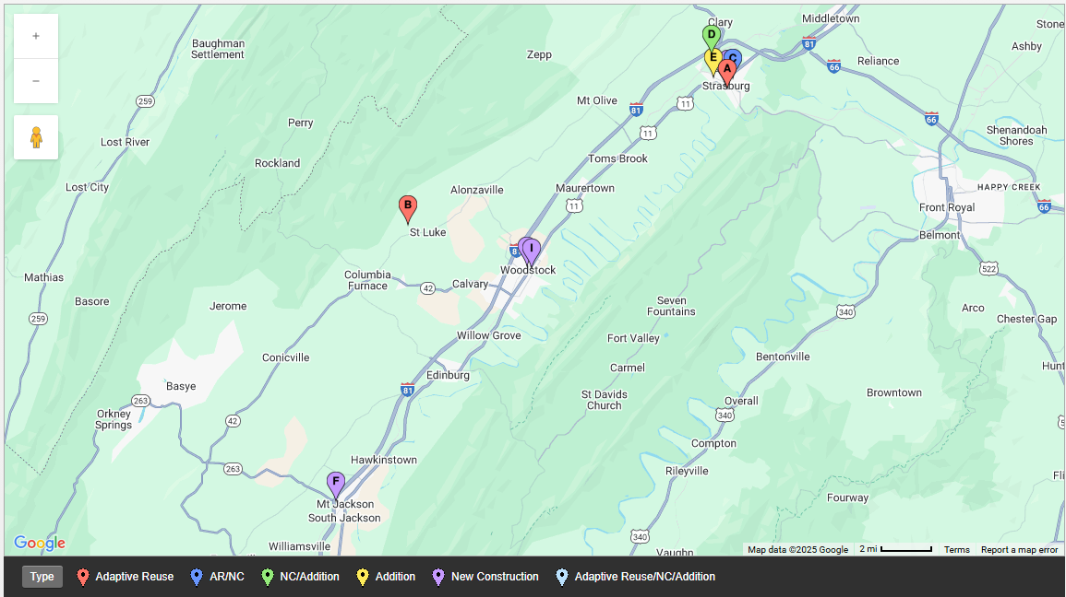
Scoring Criteria

Slide 27
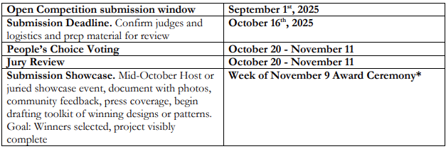
Competition Schedule
Topics | Dates
Public Announcement and Competition soliciting local property owners. | June-July
Desing Challenge Prep. Such as, Site Briefs, Rules, Budget Allocation, Judging, Criteria and Build Promo toolkit | July-August
Competition Launch & Promotion. Get the word out, begin designer/stakeholder outreach, and continue Q&A and design support workshops | August-September 1st
Homeowners Meeting | August 27th
Competition Design Brief | September 2
Information Session Q&A. Confirm judges and logistics and prep material for review | September 16th
Submission Deadline. Confirm judges and logistics and prep material for review | October 16th
Judging Showcase. Reviewing and scoring submissions. Mid-October Host or juried showcase event, document with photos, community feedback, press coverage, begin drafting toolkit of winning designs or patterns. Goal: Winners selected, project visibly complete | October-Early November
Project Completion and Final Report. Prep material for AARP Deadlines. | December 1
Be Inspired

Slide 28
Questions?!
Be Inspired

Slide 29

THANK YOU!
Be Inspired

